Slide 1

Weather Web Application
SUBMITTED BY :
NAZAM KALSI
211462
B-TECH (CSE) 5 SEMESTER
SUBMITTED TO :
Er. GAGAN LUTHRA
th

Slide 2
Introduction
The Purposed system provides the weather of different cities around the world.
In this system the user can view Weather for which they search for.
The proposed system uses weather API for searching the weather.

Slide 3
Objective
The weather app enables us to make better prepration for the day in relation to giving accurate daily weather.
Weneed Weather App to plan journey ahead.
A person travveling ina bus,train, or flight may need to check the weather in his destination city.
The system provides you with details of the weather elements -Temperature,Wind speed,humidity,pecipitation etc.

Slide 4
Tools used
Technologies used
V.S. Code
H.T.M.L
I.D.E.
C.S.S.
Windows
O.S.
Javascript
Weather API
Google Chrome
Web browser

Slide 5
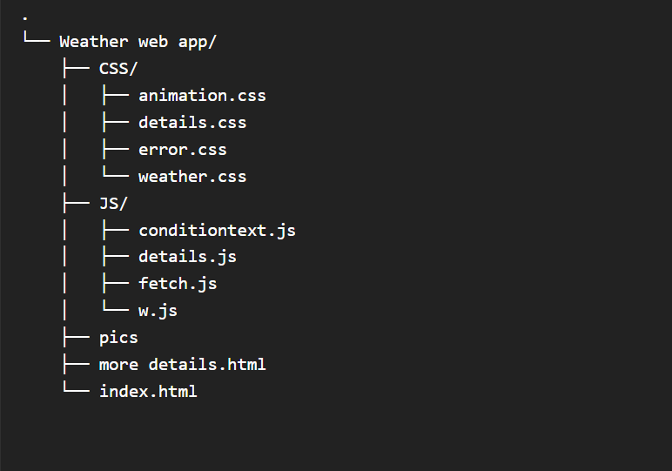
Folder Structure

Slide 6
Screenshot’s of the project

Slide 7
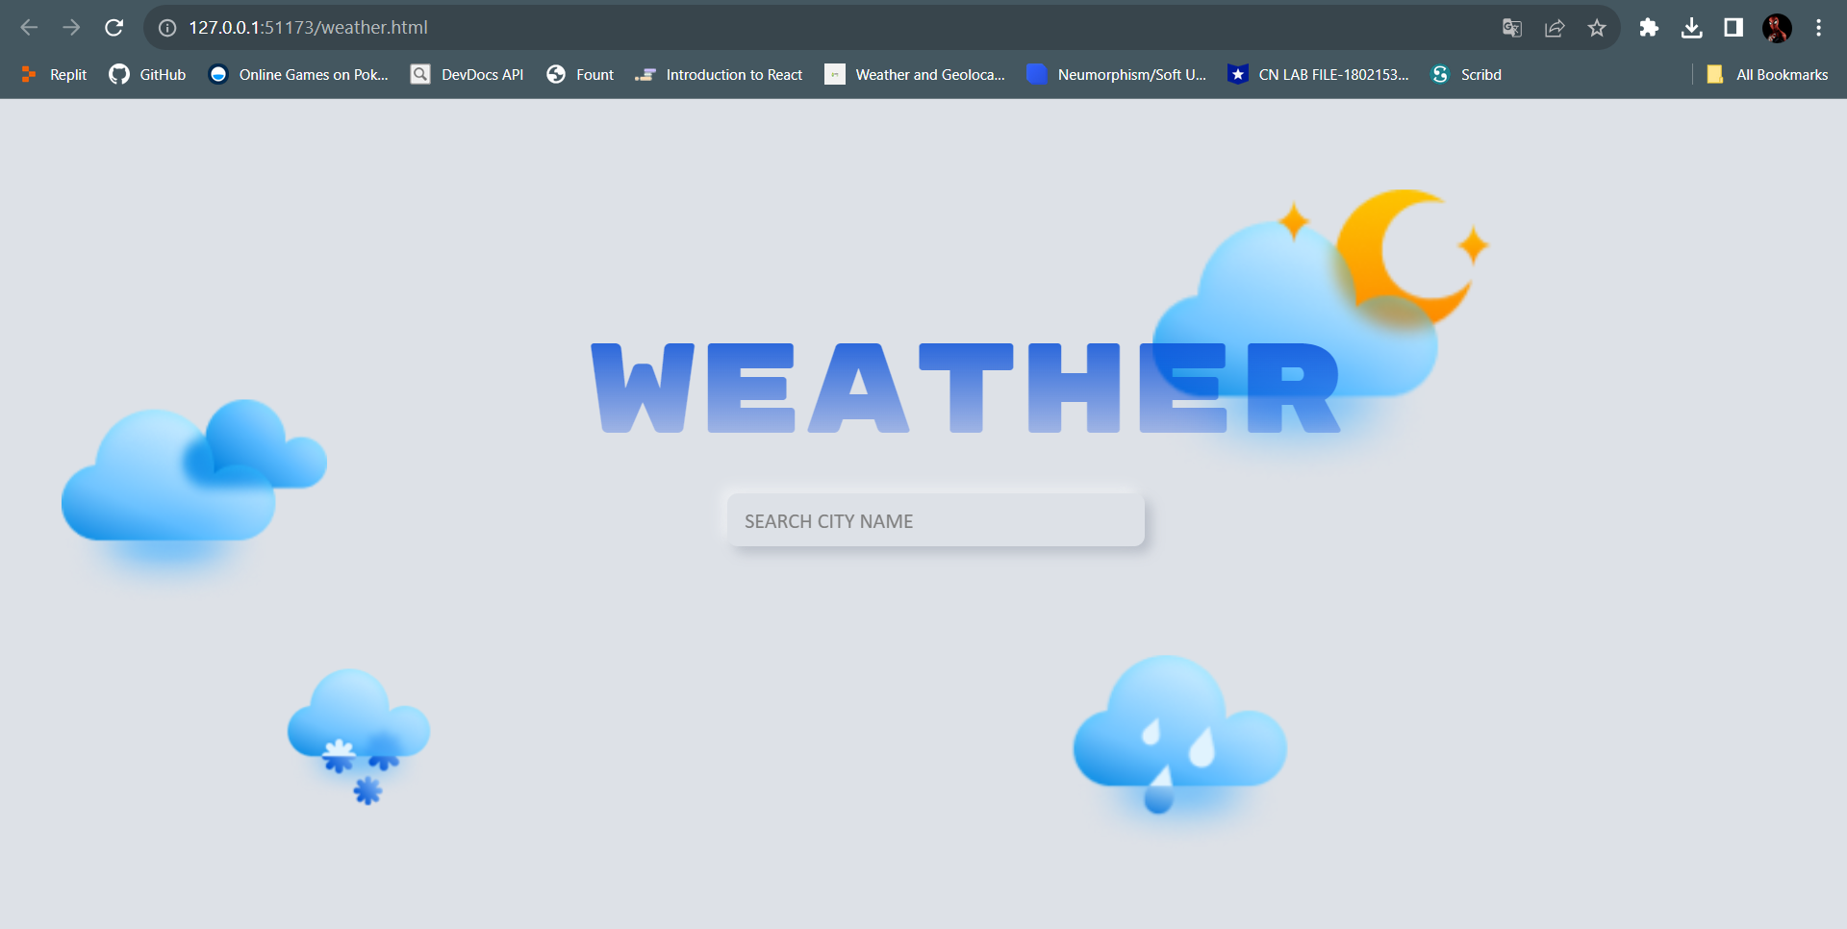
Landing Page
Search area

Slide 8
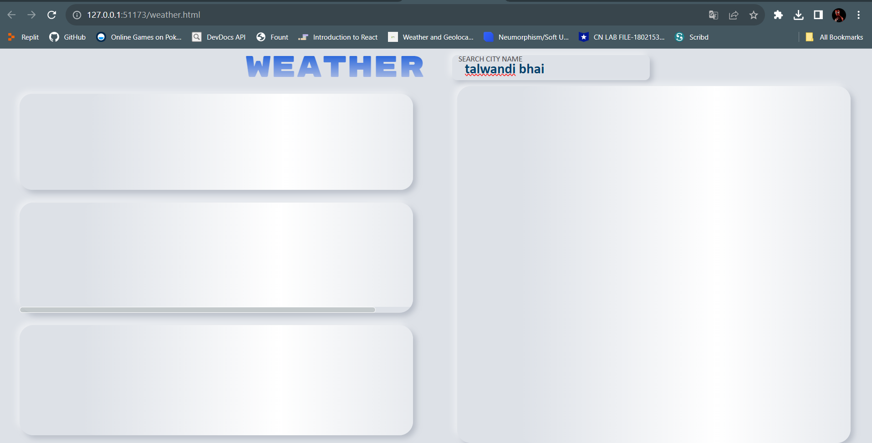
Data fetching state
Skelton loading animation

Slide 9
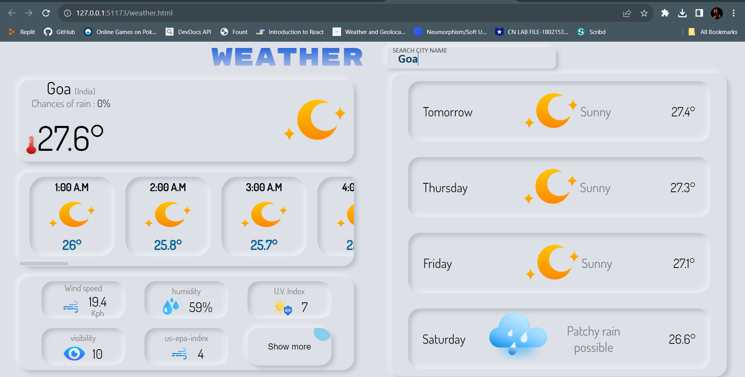
Displaying Result
Forecast Weather
Today’s Weather card
Search area
Hourly Based Weather
Day
condition
More Details
Temperature (approx.)
Button for
further details

Slide 10
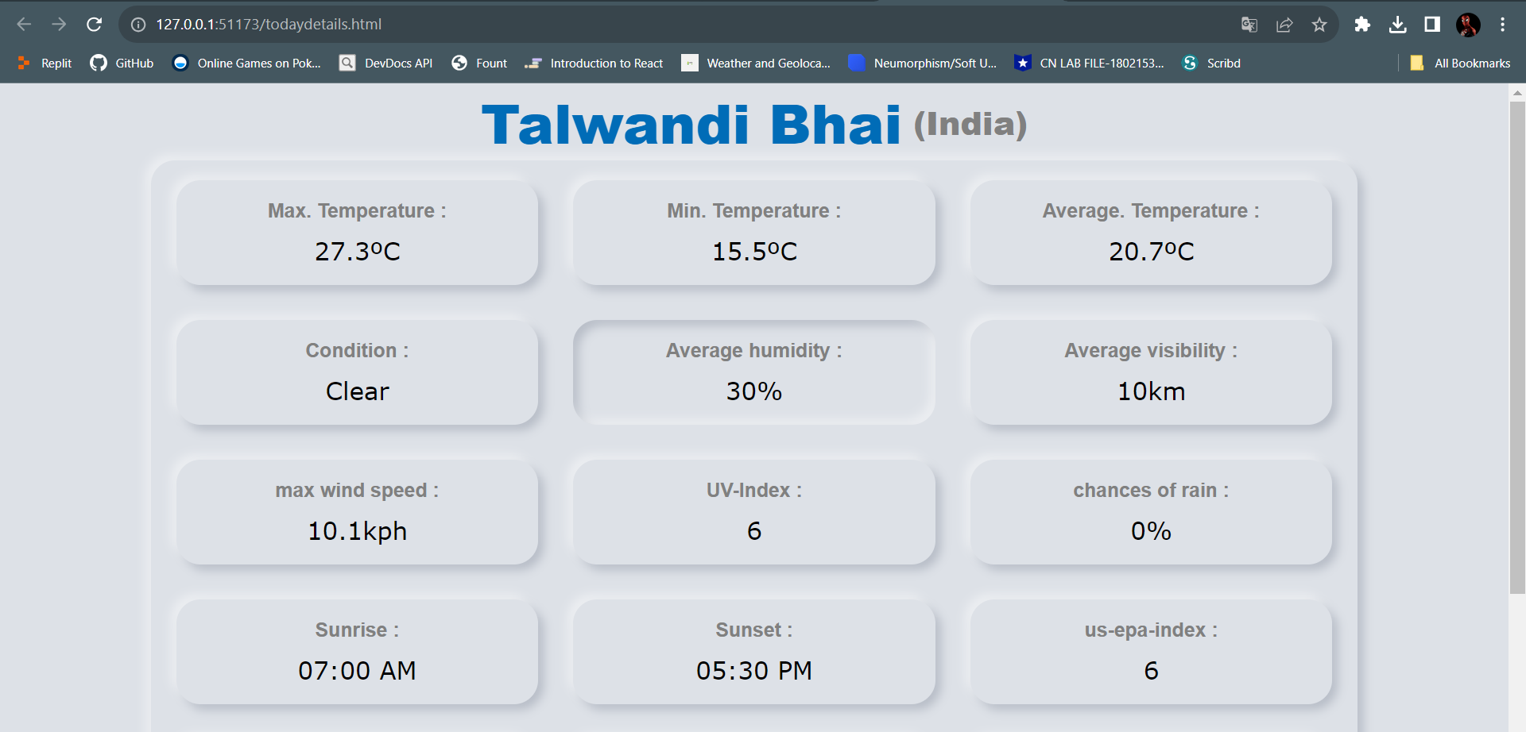
More Details
More
details

Slide 11
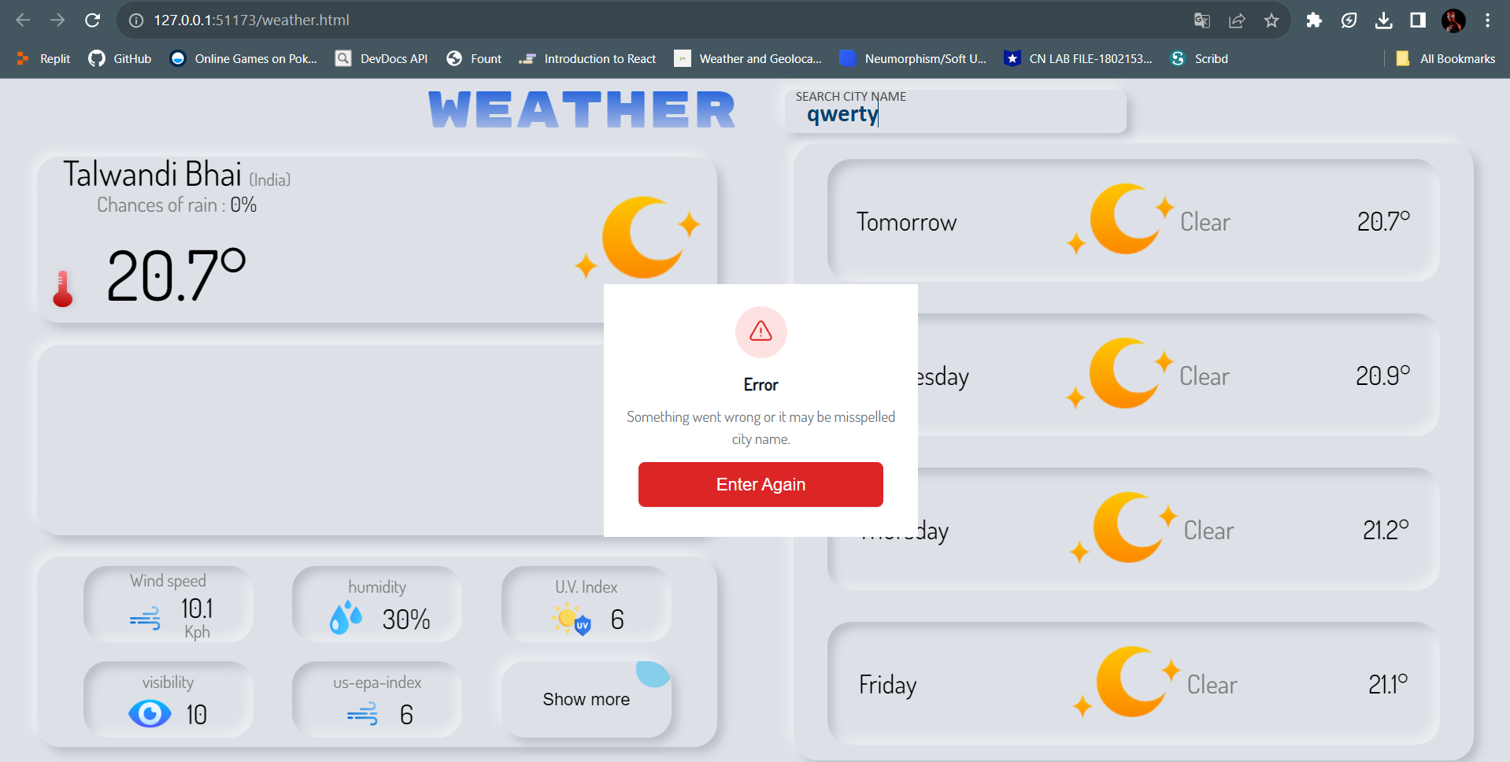
Error Displaying
Error display card

Slide 12
Thank You !

